Slide 1
Cerner MPages Framework Development Reference
Reference Information for Custom Component Development

Slide 2
What Will Be Covered
MPages Release Info
3rd party libraries
MPages Component Standard version
Blackbird Logging
Component Development Tips
Overloaded Primitive Functions

Slide 3
MPages Component Library 4.1 (November 2011)
Package Number: 55346
MPages Component Standard: 1.0
3rd Party Libraries
jQuery 1.4.4.js
jQuery UI 1.8.7 Custom
Contains: jQuery UI Core, Draggable, Mouse, Sortable, Widget
jqPlot 1.0.0b2_r1012
Contains: Cursor, DateAxisRenderer, Highlighter, MarkerRenderer, PointLabels
Blackbird Logger 1.0

Slide 4
MPages Component Library 4.2 (March 2012)
Package Number: 57115
MPages Component Standard: 1.0
3rd Party Libraries
jQuery 1.4.4.js
jQuery UI 1.8.7 Custom
Contains: jQuery UI Core, Draggable, Mouse, Sortable, Widget
jqPlot 1.0.0b2_r1012
Contains: Cursor, DateAxisRenderer, Highlighter, MarkerRenderer, PointLabels
Blackbird Logger 1.0

Slide 5
MPages Component Library 4.3 (September 2012)
Package Number: 60285
MPages Component Standard: 1.0
3rd Party Libraries
jQuery 1.4.4.js
jQuery UI 1.8.7 Custom
Contains: jQuery UI Core, Draggable, Mouse, Sortable, Widget
jqPlot 1.0.0b2_r1012
Contains: Cursor, DateAxisRenderer, Highlighter, MarkerRenderer, PointLabels
Blackbird Logger 1.0

Slide 6
MPages Component Library 4.4 (November 2012)
Package Number: 62290
MPages Component Standard: 1.0
3rd Party Libraries
jQuery 1.7.2.js
jQuery UI 1.8.7 Custom
Contains: jQuery UI Core, Draggable, Mouse, Sortable, Widget
jqPlot 1.0.0b2_r1012
Contains: Cursor, DateAxisRenderer, Highlighter, MarkerRenderer, PointLabels
Blackbird Logger 1.0

Slide 7
MPages Component Library 4.5 (March 2013)
Package Number: 64335
MPages Component Standard: 1.1
3rd Party Libraries
jQuery 1.7.2.js
jQuery UI 1.8.7 Custom
Contains: jQuery UI Core, Draggable, Mouse, Sortable, Widget
jqPlot 1.0.0b2_r1012
Contains: Cursor, DateAxisRenderer, Highlighter, MarkerRenderer, PointLabels
Blackbird Logger 1.0

Slide 8
MPages Component Library 4.6 (June 2013)
Package Number: 66200
MPages Component Standard: 1.1
3rd Party Libraries
jQuery 1.7.2.js
jQuery UI 1.8.7 Custom
Contains: jQuery UI Core, Draggable, Mouse, Sortable, Widget
jqPlot 1.0.0b2_r1012
Contains: Cursor, DateAxisRenderer, Highlighter, MarkerRenderer, PointLabels
Blackbird Logger 1.0

Slide 9
MPages Component Library 5.0 (September 2013)
Package Number: 68443
MPages Component Standard: 1.1
3rd Party Libraries
jQuery 1.7.2.js
jQuery UI 1.8.7 Custom
Contains: jQuery UI Core, Draggable, Mouse, Sortable, Widget
jqPlot 1.0.0b2_r1012
Contains: Cursor, DateAxisRenderer, Highlighter, MarkerRenderer, PointLabels
Blackbird Logger 1.0

Slide 10
MPages Services 5.0 (September 2013)
MPages EJS
Initial release provides Bedrock settings caching
MPages Static Content Enterprise Appliance
Initial release provides static content delivery via a webserver. Allows client caching of static content.

Slide 11
MPages Component Library 5.1 (January 2014)
Package Number: 69988
MPages Component Standard: 1.1
3rd Party Libraries
jQuery 1.7.2.js
jQuery UI 1.8.7 Custom
Contains: jQuery UI Core, Draggable, Mouse, Sortable, Widget
jqPlot 1.0.0b2_r1012
Contains: Cursor, DateAxisRenderer, Highlighter, MarkerRenderer, PointLabels
Blackbird Logger 1.0

Slide 12
MPages Services 5.1 (January 2014)
MPages EJS
No changes made for this release
MPages Static Content Enterprise Appliance
No changes made for this release

Slide 13
MPages Component Library 5.2 (April 2014)
Package Number: 71895
MPages Component Standard: 1.1
3rd Party Libraries
jQuery 1.7.2.js
jQuery UI 1.8.7 Custom
Contains: jQuery UI Core, Draggable, Mouse, Sortable, Widget
jqPlot 1.0.0b2_r1012
Contains: Cursor, DateAxisRenderer, Highlighter, MarkerRenderer, PointLabels
Blackbird Logger 1.0

Slide 14
MPages Services 5.2 (April 2014)
MPages EJS
No changes made for this release
MPages Static Content Enterprise Appliance
Updates to increase stability/availability of static content

Slide 15
MPages Component Library 5.3 (August 2014)
Package Number: 73308
MPages Component Standard: 1.1
3rd Party Libraries
jQuery 1.11.1.js
jQuery UI 1.10.4 Custom
Contains: jquery.ui.core.js, jquery.ui.widget.js, jquery.ui.mouse.js, jquery.ui.position.js, jquery.ui.draggable.js, jquery.ui.sortable.js, jquery.ui.autocomplete.js, jquery.ui.datepicker.js, jquery.ui.menu.js
jqPlot 1.0.0b2_r1012
Contains: Cursor, DateAxisRenderer, Highlighter, MarkerRenderer, PointLabels
Blackbird Logger 1.0

Slide 16
MPages Services 5.3 (August 2014)
Package Number: 73309
MPages EJS
No changes made for this release
MPages Static Content Enterprise Appliance
No changes made for this release

Slide 17
MPages Component Library 5.3.1 (December 2014)
Package Number: 75000
MPages Component Standard: 1.1
3rd Party Libraries
jQuery 1.11.1.js
jQuery UI 1.10.4 Custom
Contains: jquery.ui.core.js, jquery.ui.widget.js, jquery.ui.mouse.js, jquery.ui.position.js, jquery.ui.draggable.js, jquery.ui.sortable.js, jquery.ui.autocomplete.js, jquery.ui.datepicker.js, jquery.ui.menu.js
jqPlot 1.0.0b2_r1012
Contains: Cursor, DateAxisRenderer, Highlighter, MarkerRenderer, PointLabels
Blackbird Logger 1.0

Slide 18
MPages Services 5.3.1 (December 2014)
Package Number: 75002
MPages EJS
No changes made for this release
MPages Static Content Enterprise Appliance
No changes made for this release

Slide 19
MPages Component Library 5.4 (March 2015)
Package Number: 76720
MPages Component Standard: 1.1
3rd Party Libraries
jQuery 1.11.1.js
jQuery UI 1.10.4 Custom
Contains: jquery.ui.core.js, jquery.ui.widget.js, jquery.ui.mouse.js, jquery.ui.position.js, jquery.ui.draggable.js, jquery.ui.sortable.js, jquery.ui.autocomplete.js, jquery.ui.datepicker.js, jquery.ui.menu.js
jqPlot 1.0.8b2_r1250
Contains: Cursor, DateAxisRenderer, Highlighter, MarkerRenderer, PointLabels
Blackbird Logger 1.0

Slide 20
MPages Services 5.4 (March 2015)
Package Number: 76721
MPages EJS
No changes made for this release
MPages Static Content Enterprise Appliance
Updates to support Linux environments
Updates to be EA Compliant

Slide 21
MPages Component Library 5.5 (August 2015)
Package Number: 79398
MPages Component Standard: 1.1
3rd Party Libraries
jQuery 1.11.1.js
jQuery UI 1.10.4 Custom
Contains: jquery.ui.core.js, jquery.ui.widget.js, jquery.ui.mouse.js, jquery.ui.position.js, jquery.ui.draggable.js, jquery.ui.sortable.js, jquery.ui.autocomplete.js, jquery.ui.datepicker.js, jquery.ui.menu.js
jqPlot 1.0.0b2_r1012
Contains: Cursor, DateAxisRenderer, Highlighter, MarkerRenderer, PointLabels
Blackbird Logger 1.0

Slide 22
MPages Services 5.5 (August 2015)
Package Number: 79408
MPages EJS
No changes made for this release
MPages Static Content Enterprise Appliance
Support for content folders with special characters in the name

Slide 23
MPages Component Library 5.6 (October 2015)
Package Number: 82258
MPages Component Standard: 1.1
3rd Party Libraries
jQuery 1.11.1.js
jQuery UI 1.10.4 Custom
Contains: jquery.ui.core.js, jquery.ui.widget.js, jquery.ui.mouse.js, jquery.ui.position.js, jquery.ui.draggable.js, jquery.ui.sortable.js, jquery.ui.autocomplete.js, jquery.ui.datepicker.js, jquery.ui.menu.js
jqPlot 1.0.0b2_r1012
Contains: Cursor, DateAxisRenderer, Highlighter, MarkerRenderer, PointLabels
Blackbird Logger 1.0

Slide 24
MPages Services 5.6 (October 2015)
Package Number: 82259
MPages EJS
No changes made for this release
MPages Static Content Enterprise Appliance
No changes made for this release

Slide 25
MPages Component Library 5.7 (ETA December 2015)
Package Number: 84164
MPages Component Standard: 1.1
3rd Party Libraries
jQuery 1.11.1.js
jQuery UI 1.10.4 Custom
Contains: jquery.ui.core.js, jquery.ui.widget.js, jquery.ui.mouse.js, jquery.ui.position.js, jquery.ui.draggable.js, jquery.ui.sortable.js, jquery.ui.autocomplete.js, jquery.ui.datepicker.js, jquery.ui.menu.js
jqPlot 1.0.0b2_r1012
Contains: Cursor, DateAxisRenderer, Highlighter, MarkerRenderer, PointLabels
Blackbird Logger 1.0

Slide 26
MPages Services 5.7 (ETA December 2015)
Package Number: 84166
MPages EJS
No changes made for this release
MPages Static Content Enterprise Appliance
No changes made for this release

Slide 27
MPages Component Library 6.0 (ETA March 2016)
Package Number: TBD
MPages Component Standard: 1.1
3rd Party Libraries
jQuery 2.1.4
jQuery UI 1.11.4 Custom
Contains: core.js, widget.js, mouse.js, position.js, draggable.js, sortable.js, autocomplete.js, datepicker.js, menu.js
jQuery plugins
jQuery Multiselect UI Widget 1.13
jQuery.scrollTo 2.1.1
jQuery.serialScroll 1.3.1
jQuery-timepicker 1.8.1

Slide 28
MPages Component Library 6.0 (ETA March 2016)
3rd Party Libraries Cont
jqPlot 1.0.0b2_r1012
Contains: Cursor, DateAxisRenderer, Highlighter, MarkerRenderer, PointLabels
Blackbird Logger 1.0

Slide 29
MPages Services 6.0 (ETA March 2016)
Package Number: TBD
MPages EJS
No changes made for this release
MPages Static Content Enterprise Appliance
No changes made for this release

Slide 30
Blackbird Logging
Available on all MPages releases since 4.1
Added to provide supplemental information for developers and support staff
Logging only occurs after activation, so no resources used until needed
Controls
Activated using the ‘ctrl + \’ key combination
Only active for the current session and the next refresh
Hide/Show: F2
Relocate the window: Shift + F2

Slide 31
Blackbird Logging
Logging info to the Blackbird Logger
These will only work within the Cerner MPages framework
MP_Util.LogError(“Error Message”);
MP_Util.LogWarn(“Warning Message”);
MP_Util.LogInfo(“Info Message”);
MP_Util.LogDebug(“Debug Message”);

Slide 32
Component Development Tips and Tricks
When developing custom components provide an actual reference to the static content instead of leaving it blank. (MPages 5.0+)
This will force the MPages View to access the static_content directly, so upon each refresh the current version of your custom-components.js and custom-components.css files will be utilized.
Follow this guide to setup a tab within the Millennium application
Unified Driver and Parameter String
Instead of leaving the static content path blank, insert the path to the UnifiedContent folder located in your code warehouse.
Ex. I:\\winintel\\static_content\\UnifiedContent
Be sure to escape the backslashes as shown above
This path may differ based on your

Slide 33
Overloaded Primitive Functions as of MPages 4.4
Prior to Custom Component development the MPages team didn’t police modification to the primitive types since all development was done in house
Since this has become an issue we will attempt to document all of the existing modifications and prevent any future modification unless absolutely necessary
The following slides contain all of the known overloaded primitive functions with a short description of what they do
Some functions are now part of the ECMAScript (JavaScript) standard and have been marked as such.

Slide 34
Overloaded Primitive Functions - Array
Array.prototype.addAll(v) (Removed in 6.0)
This function adds all of the elements contained within Array ‘v’ to the current array
Array.prototype.each(c) (Removed in 5.0)
Performs the specific function ‘c(index, element)’ for every element in the current array.
Array.prototype.replace(e, d, c) (Removed in 5.0)
Do not use this!
Array.prototype.isEmpty( ) (Removed in 5.0)
Returns true if the current array is empty, false otherwise
Array.prototype.contains(a) (Removed in 5.0)
Returns true if the current array contains element a, false otherwise.

Slide 35
Overloaded Primitive Functions - Array
Array.prototype.remove(c) (Removed in 5.0)
Removes the first occurrence of element c within the current array.
Array.prototype.removeAll(c) (Removed in 5.0)
Removes all occurrences of element c within the current array.
Array.prototype.insert(c, b) (Removed in 5.0)
Inserts element c at index b of the current array
Array.prototype.insertAll(b, a) (Removed in 5.0)
Inserts all elements in array b at index a of the current array
Array.prototype.and(f) (Removed in 5.0)
Performs a logical AND between the current array and array f

Slide 36
Overloaded Primitive Functions - Array
Array.prototype.not(a) (Removed in 5.0)
Performs a logical NOT between the current array and array a
Array.prototype.equals(a) (Removed in 5.0)
Checks to see if the current array is equal to array a
Array.prototype.containsAny(a) (Removed in 5.0)
Checks to see if any element of array a are contained with the current array
Array.prototype.containsAll(s) (Removed in 5.0)
Checks to see if all elements within array s are contained within the current array
Array.prototype.indexOf(o) (Standard function in 6.0)
Returns the index of element o within the current array, otherwise returns -1

Slide 37
Overloaded Primitive Functions - Array
Array.prototype.map(c, a) (Standard function in 6.0)
Creates a new array with the results of calling a provided function c on every element in this array using ‘a’ as the calling object.
MPages prior to 6.0 – use this function at your own risk. The implementation was not standard for JavaScript (ECMAScript) in IE8.
MPages after 6.0 – This function is now a standard function for JavaScript (ECMAScript) in IE9+ so its use is encouraged.
Array.prototype.sortByProp(a) (Removed in 6.0)
Sorts an array by a specific property
Introduced in MPages 5.5

Slide 38
Overloaded Primitive Functions - String
String.prototype.toJSON( ) (Standard function in 6.0)
Returns the same result of string.valueOf();
String.prototype.trim( ) (Standard function in 6.0)
Trims the leading and trailing spaces of the current string
String.prototype.padStartWithZeroes(b) (Removed in 5.0)
Adds b zeroes onto the beginning of the current string
String.prototype.padEndWithZeroes(b) (Removed in 5.0)
Adds b zeroes onto the end of the current string
String.prototype.removeTrailingZeroes( ) (Removed in 5.0)
Removes the trailing zeroes from the current string

Slide 39
Overloaded Primitive Functions - String
String.prototype.repeat(c)
Duplicates the current string c number of times
String.prototype.interpolate(c)
Interpolates the current string based on object c

Slide 40
Overloaded Primitive Functions - Boolean
Boolean.prototype.toJSON( ) (Standard function in 6.0)
Returns the same result as Boolean.valueOf( );

Slide 41
Overloaded Primitive Functions - Number
Number.prototype.removeTrailingZeroes( ) (Removed in 5.0)
Removes the trailing zeroes from the current number
Do not use!
Number.prototype.toJSON( ) (Standard function in 6.0)
Returns the same result as Number.valueOf( );

Slide 42
Overloaded Primitive Functions - Function
Function.prototype.method(n, f)
Creates a prototype function f referenced by the name n for the current function
Do not use!
Function.prototype.createAttribute(n,d)
Creates a variable ‘m_n’ with default value of d. Also creates getter and setter functions with the names ‘getn’ and ‘setn’
Function.prototype.bind(o) (Standard function in 6.0)
Binds a function to the object o, so that o is considered ‘this’ when the function is called.
As of MPages 6.0 this function is part of the Function object supported by the minimum browser version (IE9). All previous versions will have an implementation provided.

Slide 43
Overloaded Primitive Functions - Date
Date.prototype.toJSON( ) (Standard function in 6.0)
Return the date in a string of the following format YYYY-MM-DDTHH:MM:SS.mmmZ
Date.prototype.midnight( ) (Removed in 5.0)
Changes the time to midnight for the current date object
Date.prototype.setISO8601(dateString)
Takes an iso8601 formatted date string and parses it into a date object

Slide 44
Overloaded Primitive Functions - Date
Date.prototype.format(mask)
Formats this date object based on the provided mask
Use: new Date().format(“longDateTime”);
Masks defined on subsequent slides for each region

Slide 45
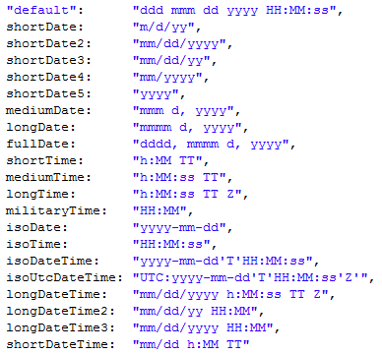
Overloaded Primitive Functions - Date
Mask forms and identifiers for Date.prototype.format (US clients)

Slide 46
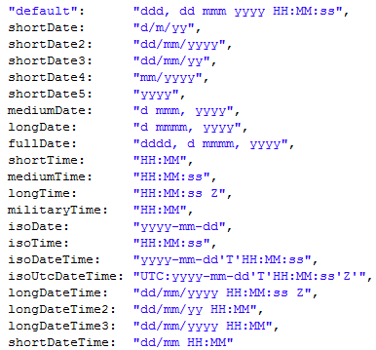
Overloaded Primitive Functions - Date
Mask forms and identifiers for Date.prototype.format (Fr clients)

Slide 47
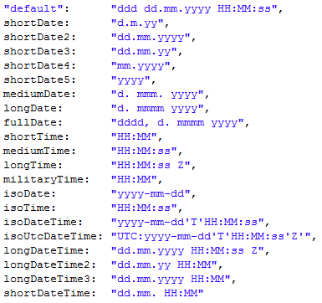
Overloaded Primitive Functions - Date
Mask forms and identifiers for Date.prototype.format (De clients)

Slide 48
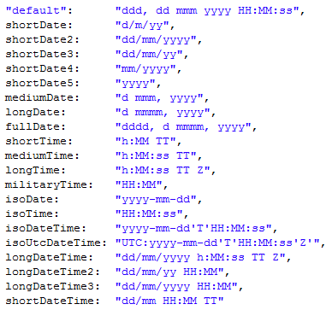
Overloaded Primitive Functions - Date
Mask forms and identifiers for Date.prototype.format (En_Au clients)

Slide 49
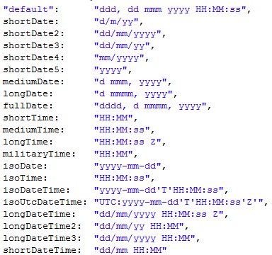
Overloaded Primitive Functions - Date
Mask forms and identifiers for Date.prototype.format (En_GB clients)

Slide 50
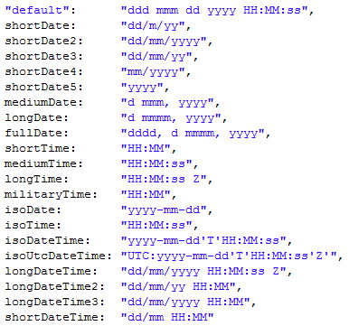
Overloaded Primitive Functions - Date
Mask forms and identifiers for Date.prototype.format (Es clients)

